Slide 1
3.6: Low-Fidelity Prototyping: Paper & Sketches
Minal Bombatkar

Slide 2
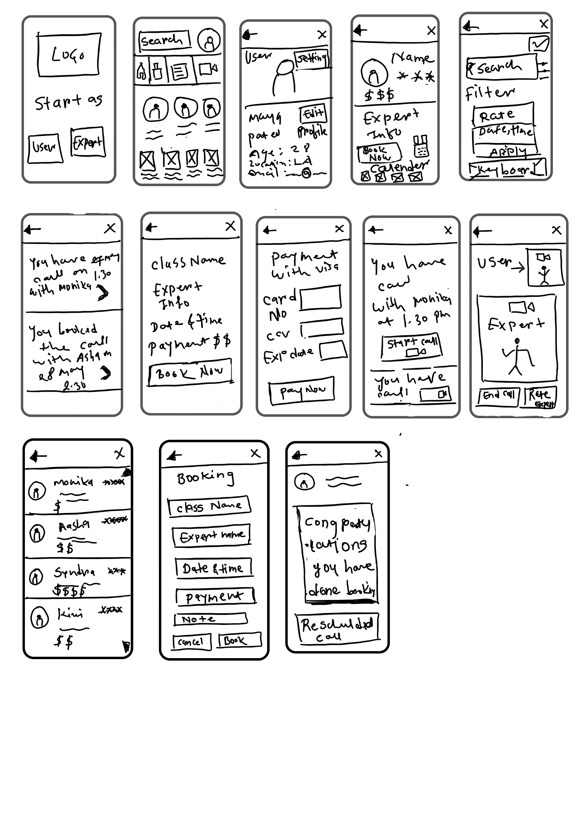

Search for yoga expert: Mobile
Home
Search yoga expert
Result for search
Yoga expert profile

Slide 3

Booking a call with an expert: Mobile
Yoga expert profile
Booking
Payment
Conformation for booking

Slide 4
Reviewing an expert: Mobile
Post review
Home
Remainder for class
Video call
Post review
Home
Remainder for class
Video call

Slide 5
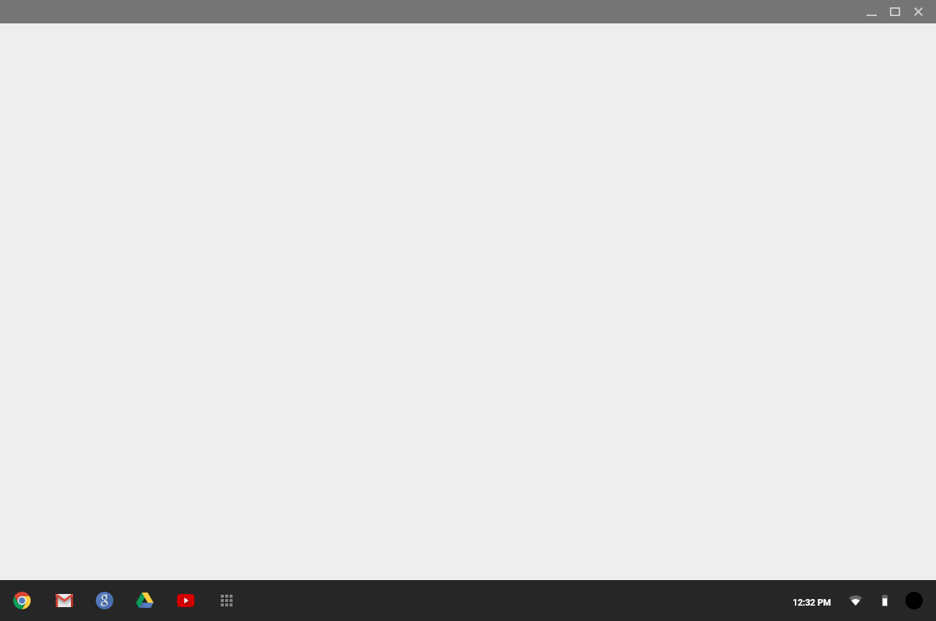
Search for yoga expert: Desktop
Home
Search yoga expert

Slide 6
Search for yoga expert: Desktop
Result for search
Yoga expert profile

Slide 7
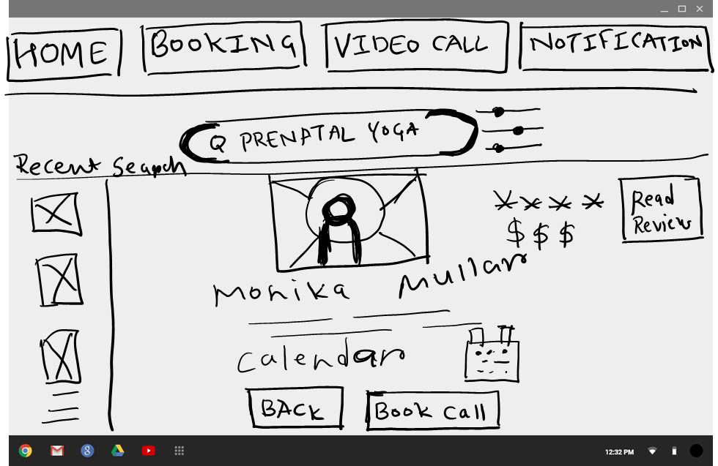
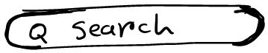
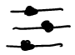
Booking a call with an expert: Desktop
Yoga expert profile
Booking

Slide 8
Booking a call with an expert: Desktop
Payment
Conformation for booking

Slide 9

Reviewing an expert: Desktop
Home

Slide 10
Reviewing an expert: Desktop
Video call
Post review

